Slide 1
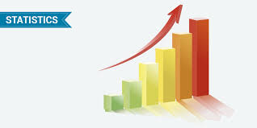
DATA ANALYSIS USING DESCIPTIVE
STATISTICS

Slide 2
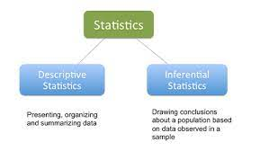

Slide 3
Descriptive statistics are brief information coefficient that summarize a given data set, which can be either a representation of the entire population or a sample of a population.

Slide 4
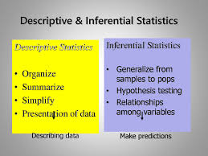

Slide 5
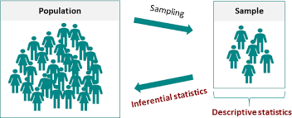

Slide 6
Descriptive statics insides 1# Measures of central tendency 2# Measures of asymmetry 3# Measures of variability 4# Measures of relationships

Slide 7
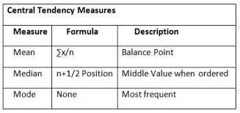
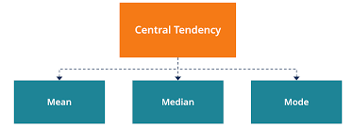

Slide 8
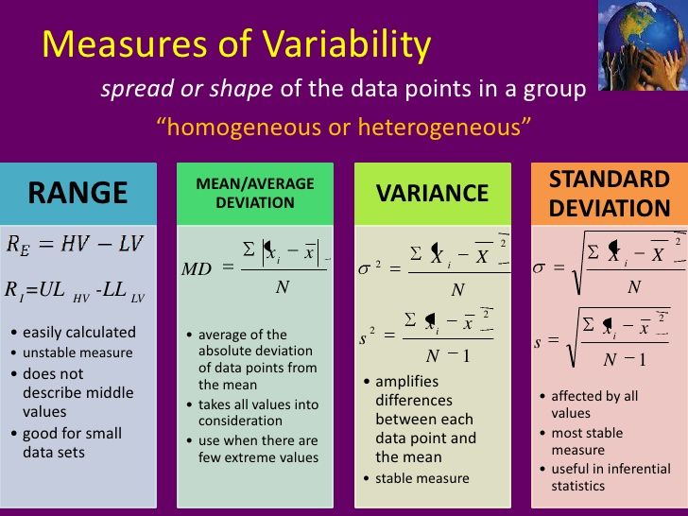
Measures of variability

Slide 9
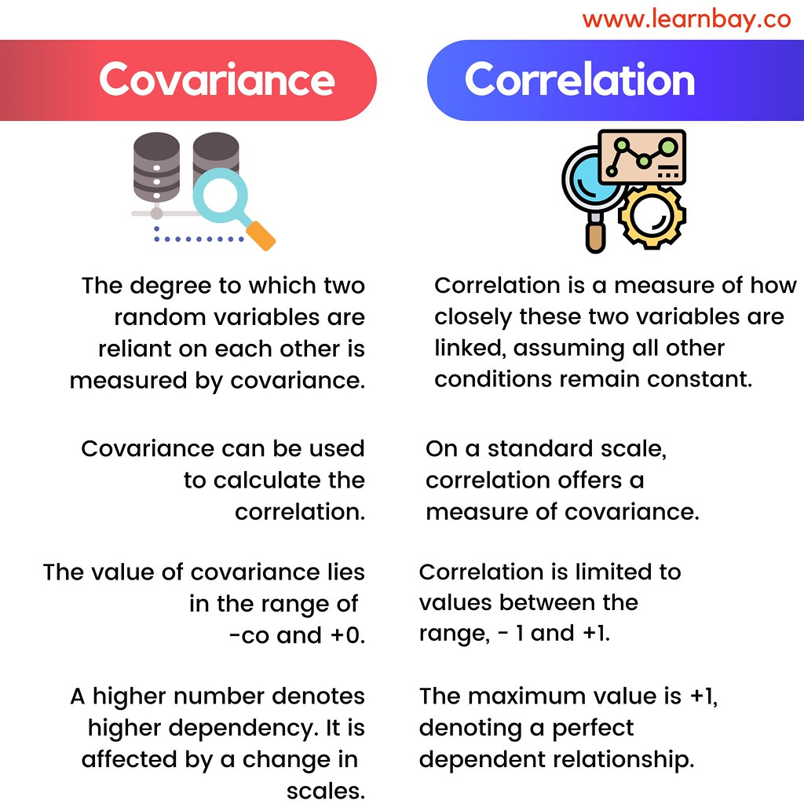
Measures of relationships

Slide 10
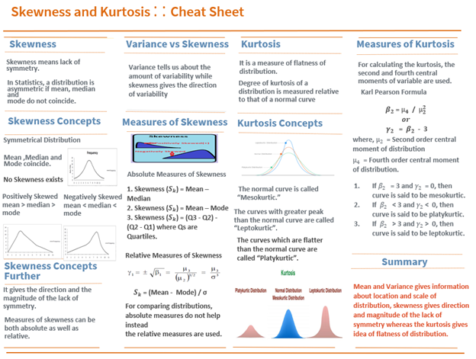
Measures of assymetry

Slide 11
import numpy as np
import pandas as pd
Having imported numpy and pandas module of python.
Pandas mainly works with the tabular data.
Whereas numpy works with numerical data.
import os
os.getcwd()
output
'C:\\Users\\DELL’
#Load the cardio dataset
import pandas as pd
myData=pd.read_csv('CardioGoodFitness (1).csv')

Slide 12
ABOUT DATASET
The market research team at AdRight is assigned the task to identify the profile of the typical customer for each treadmill product offered by CardioGood Fitness. The market research team decides to investigate whether there are differences across the product lines with respect to customer characteristics. The team decides to collect data on individuals who purchased a treadmill at a CardioGoodFitness retail store during the prior three months. The data are stored in the CardioGoodFitness.csv file. The team identifies the following customer variables to study: product purchased, TM195, TM498, or TM798; gender; age, in years;education, in years; relationship status, single or partnered; annual household income ($); average number of times the customer plans to use the treadmill each week; average number of miles the customer expects to walk/run each week; and self-rated fitness on an 1-to-5 scale, where 1 is poor shape and 5 is excellent shape. Perform descriptive analytics to create a customer profile for each CardioGood Fitness treadmill product line.

Slide 13
.head()→ this function returns the first
N rows for the object by default it gives
First five rows
myData.head()
 | Product | Age | Gender | Education | MaritalStatus | Usage | Fitness | Income | Miles
0 | TM195 | 18 | Male | 14 | Single | 3 | 4 | 29562 | 112
1 | TM195 | 19 | Male | 15 | Single | 2 | 3 | 31836 | 75
2 | TM195 | 19 | Female | 14 | Partnered | 4 | 3 | 30699 | 66
3 | TM195 | 19 | Male | 12 | Single | 3 | 3 | 32973 | 85
4 | TM195 | 20 | Male | 13 | Partnered | 4 | 2 | 35247 | 47
Out[19]:

Slide 14
myData.describe()
ouput
 | Age | Education | Usage | Fitness | Income | Miles
count | 180.000000 | 180.000000 | 180.000000 | 180.000000 | 180.000000 | 180.000000
mean | 28.788889 | 15.572222 | 3.455556 | 3.311111 | 53719.577778 | 103.194444
std | 6.943498 | 1.617055 | 1.084797 | 0.958869 | 16506.684226 | 51.863605
min | 18.000000 | 12.000000 | 2.000000 | 1.000000 | 29562.000000 | 21.000000
25% | 24.000000 | 14.000000 | 3.000000 | 3.000000 | 44058.750000 | 66.000000
50% | 26.000000 | 16.000000 | 3.000000 | 3.000000 | 50596.500000 | 94.000000
75% | 33.000000 | 16.000000 | 4.000000 | 4.000000 | 58668.000000 | 114.750000
max | 50.000000 | 21.000000 | 7.000000 | 5.000000 | 104581.000000 | 360.000000

Slide 15
Analysis of quantitative variables.
The age range of those purchasing the treadmills is 18 to 50 years old, with an average age of 28. The average education of customers is 15 years, with a range of 12 to 21 years of education. The average household income of customers is about 53,719USD annually, ranging from as low as 29562USD to 103581USD. The average self-rated fitness of customers is 3.3 (on the scale of 1-5), with a range of 1-5. On average, customers said they would use the treadmill 3 times a week, with some going as low 2 times weekly to as high as 7 times weekly. The average miles expected to be run by the customers weekly is 103 miles, ranging from 23 miles to 360 miles.

Slide 16
myData.info()
Pandas datafram info() method prints information about dataframe.contains
No. of columns,labels,datatype,memory usage ,range index and no of cell in each column (non null valuses)
<class 'pandas.core.frame.DataFrame'> RangeIndex: 180 entries, 0 to 179 Data columns (total 9 columns): # Column Non-Null Count Dtype --- ------ -------------- ----- 0 Product 180 non-null object 1 Age 180 non-null int64 2 Gender 180 non-null object 3 Education 180 non-null int64 4 MaritalStatus 180 non-null object 5 Usage 180 non-null int64 6 Fitness 180 non-null int64 7 Income 180 non-null int64 8 Miles 180 non-null int64 dtypes: int64(6), object(3) memory usage: 12.8+ KB

Slide 17
The shape of a dataframe is a tuple of array dimensions that tells the number of rows and columns of given dataframe
myData.shape
INSIDE’S FROM
DATA
180 records with 9
Attributes in dataset.
No missing value found
output
(180, 9)
(180, 9)
isna() function detect missing values in the given object
any() function returns true if any item in an iterable are true ,otherwise false
myData.isna().any()
Product False Age False Gender False Education False MaritalStatus False Usage False Fitness False Income False Miles False dtype: boo lian
Matplot lib is cross platform,data visualization and graphical library.
.hist()→is used to plot histogram.
import matplotlib.pyplot as plt
%matplotlib inline
myData.hist(figsize=(20,20))

Slide 18
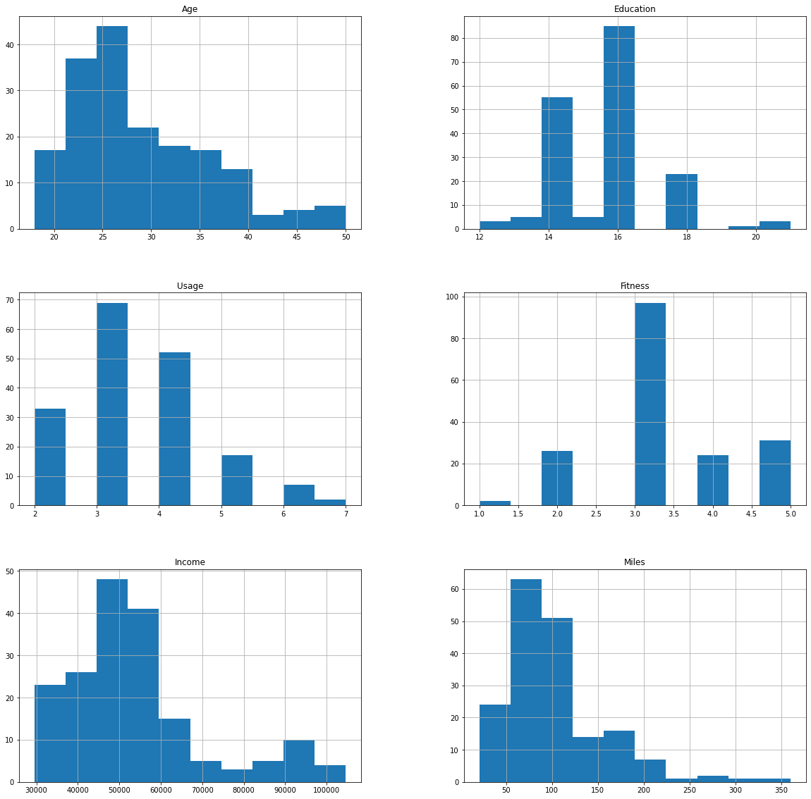
array([[<AxesSubplot:title={'center':'Age'}>, <AxesSubplot:title={'center':'Education'}>], [<AxesSubplot:title={'center':'Usage'}>, <AxesSubplot:title={'center':'Fitness'}>], [<AxesSubplot:title={'center':'Income'}>, <AxesSubplot:title={'center':'Miles'}>]], dtype=object)

Slide 19
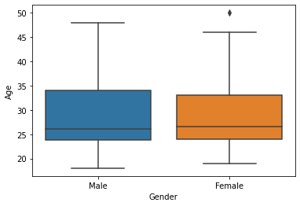
import pandas as pd
pd.crosstab(myData['Product'],myData['Gender'])
import seaborn as sns
sns.boxplot(x='Gender',y='Age',data=myData)
Gender | Female | Male
Product
TM195 | 40 | 40
TM498 | 29 | 31
TM798 | 7 | 33

Slide 20
Insights
For the TM195 model, the same amount of males and females purchased. More males bought the TM798 and TM498 model, with the former being skewed more heavily towards males than the latter.

Slide 21
pd.crosstab(myData['Age'],myData['Income'])
Income | 29562 | 30699 | 31836 | 32973 | 34110 | 35247 | 36384 | 37521 | 38658 | 39795 | ... | 85906 | 88396 | 89641 | 90886 | 92131 | 95508 | 95866 | 99601 | 103336 | 104581
Age
18 | 1 | 0 | 0 | 0 | 0 | 0 | 0 | 0 | 0 | 0 | ... | 0 | 0 | 0 | 0 | 0 | 0 | 0 | 0 | 0 | 0
19 | 0 | 1 | 2 | 1 | 0 | 0 | 0 | 0 | 0 | 0 | ... | 0 | 0 | 0 | 0 | 0 | 0 | 0 | 0 | 0 | 0
20 | 0 | 0 | 0 | 2 | 1 | 1 | 0 | 0 | 1 | 0 | ... | 0 | 0 | 0 | 0 | 0 | 0 | 0 | 0 | 0 | 0
21 | 0 | 0 | 0 | 2 | 2 | 2 | 0 | 1 | 0 | 0 | ... | 0 | 0 | 0 | 0 | 0 | 0 | 0 | 0 | 0 | 0
22 | 0 | 0 | 0 | 0 | 0 | 2 | 2 | 0 | 0 | 0 | ... | 0 | 0 | 0 | 0 | 0 | 0 | 0 | 0 | 0 | 0
23 | 0 | 0 | 0 | 0 | 2 | 0 | 1 | 0 | 4 | 1 | ... | 0 | 0 | 0 | 0 | 0 | 0 | 0 | 0 | 0 | 0
24 | 0 | 0 | 0 | 0 | 0 | 0 | 0 | 0 | 0 | 0 | ... | 0 | 0 | 0 | 0 | 0 | 0 | 0 | 0 | 0 | 0
25 | 0 | 0 | 0 | 0 | 0 | 0 | 0 | 0 | 0 | 1 | ... | 0 | 0 | 0 | 0 | 0 | 0 | 0 | 0 | 0 | 0
26 | 0 | 0 | 0 | 0 | 0 | 0 | 1 | 0 | 0 | 0 | ... | 0 | 0 | 0 | 0 | 0 | 0 | 0 | 0 | 0 | 0
27 | 0 | 0 | 0 | 0 | 0 | 0 | 0 | 0 | 0 | 0 | ... | 0 | 1 | 0 | 1 | 0 | 0 | 0 | 0 | 0 | 0
28 | 0 | 0 | 0 | 0 | 0 | 0 | 0 | 0 | 0 | 0 | ... | 0 | 1 | 0 | 0 | 1 | 0 | 0 | 0 | 0 | 0
29 | 0 | 0 | 0 | 0 | 0 | 0 | 0 | 0 | 0 | 0 | ... | 1 | 0 | 0 | 0 | 0 | 0 | 0 | 0 | 0 | 0
30 | 0 | 0 | 0 | 0 | 0 | 0 | 0 | 0 | 0 | 0 | ... | 0 | 0 | 0 | 1 | 0 | 0 | 0 | 1 | 1 | 0
31 | 0 | 0 | 0 | 0 | 0 | 0 | 0 | 0 | 0 | 0 | ... | 0 | 0 | 1 | 0 | 0 | 0 | 0 | 0 | 0 | 0
32 | 0 | 0 | 0 | 0 | 0 | 0 | 0 | 0 | 0 | 0 | ... | 0 | 0 | 0 | 0 | 0 | 0 | 0 | 0 | 0 | 0
33 | 0 | 0 | 0 | 0 | 0 | 0 | 0 | 0 | 0 | 0 | ... | 0 | 0 | 0 | 0 | 0 | 0 | 1 | 0 | 0 | 0
34 | 0 | 0 | 0 | 0 | 0 | 0 | 0 | 0 | 0 | 0 | ... | 0 | 0 | 0 | 0 | 1 | 0 | 0 | 0 | 0 | 0
35 | 0 | 0 | 0 | 0 | 0 | 0 | 0 | 0 | 0 | 0 | ... | 0 | 0 | 0 | 0 | 1 | 0 | 0 | 0 | 0 | 0
36 | 0 | 0 | 0 | 0 | 0 | 0 | 0 | 0 | 0 | 0 | ... | 0 | 0 | 0 | 0 | 0 | 0 | 0 | 0 | 0 | 0
37 | 0 | 0 | 0 | 0 | 0 | 0 | 0 | 1 | 0 | 0 | ... | 0 | 0 | 0 | 0 | 0 | 0 | 0 | 0 | 0 | 0
38 | 0 | 0 | 0 | 0 | 0 | 0 | 0 | 0 | 0 | 0 | ... | 0 | 0 | 0 | 0 | 0 | 0 | 0 | 0 | 0 | 1
39 | 0 | 0 | 0 | 0 | 0 | 0 | 0 | 0 | 0 | 0 | ... | 0 | 0 | 0 | 0 | 0 | 0 | 0 | 0 | 0 | 0
40 | 0 | 0 | 0 | 0 | 0 | 0 | 0 | 0 | 0 | 0 | ... | 0 | 0 | 0 | 0 | 0 | 0 | 0 | 0 | 0 | 0
41 | 0 | 0 | 0 | 0 | 0 | 0 | 0 | 0 | 0 | 0 | ... | 0 | 0 | 0 | 0 | 0 | 0 | 0 | 0 | 0 | 0
42 | 0 | 0 | 0 | 0 | 0 | 0 | 0 | 0 | 0 | 0 | ... | 0 | 0 | 1 | 0 | 0 | 0 | 0 | 0 | 0 | 0
43 | 0 | 0 | 0 | 0 | 0 | 0 | 0 | 0 | 0 | 0 | ... | 0 | 0 | 0 | 0 | 0 | 0 | 0 | 0 | 0 | 0
44 | 0 | 0 | 0 | 0 | 0 | 0 | 0 | 0 | 0 | 0 | ... | 0 | 0 | 0 | 0 | 0 | 0 | 0 | 0 | 0 | 0
45 | 0 | 0 | 0 | 0 | 0 | 0 | 0 | 0 | 0 | 0 | ... | 0 | 0 | 0 | 1 | 0 | 0 | 0 | 0 | 0 | 0
46 | 0 | 0 | 0 | 0 | 0 | 0 | 0 | 0 | 0 | 0 | ... | 0 | 0 | 0 | 0 | 0 | 0 | 0 | 0 | 0 | 0
47 | 0 | 0 | 0 | 0 | 0 | 0 | 0 | 0 | 0 | 0 | ... | 0 | 0 | 0 | 0 | 0 | 0 | 0 | 0 | 0 | 1
48 | 0 | 0 | 0 | 0 | 0 | 0 | 0 | 0 | 0 | 0 | ... | 0 | 0 | 0 | 0 | 0 | 1 | 0 | 0 | 0 | 0
50 | 0 | 0 | 0 | 0 | 0 | 0 | 0 | 0 | 0 | 0 | ... | 0 | 0 | 0 | 0 | 0 | 0 | 0 | 0 | 0 | 0

Slide 22
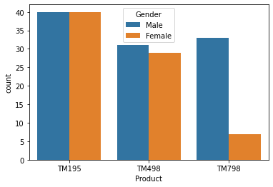
sns.countplot(x="Product",hue='Gender',data=myData)
pd.pivot_table(myData,index=['Product','Gender’], columns=['MaritalStatus'],aggfunc=len)
Age |  | Fitness |  | Income |  | Miles |  | Usage
 | MaritalStatus | Partnered | Single | Partnered | Single | Partnered | Single | Partnered | Single | Partnered | Single
Product | Gender
TM195 | Female | 27 | 13 | 27 | 13 | 27 | 13 | 27 | 13 | 27 | 13
 | Male | 21 | 19 | 21 | 19 | 21 | 19 | 21 | 19 | 21 | 19
TM498 | Female | 15 | 14 | 15 | 14 | 15 | 14 | 15 | 14 | 15 | 14
 | Male | 21 | 10 | 21 | 10 | 21 | 10 | 21 | 10 | 21 | 10
TM798 | Female | 4 | 3 | 4 | 3 | 4 | 3 | 4 | 3 | 4 | 3
 | Male | 19 | 14 | 19 | 14 | 19 | 14 | 19 | 14 | 19 | 14

Slide 23
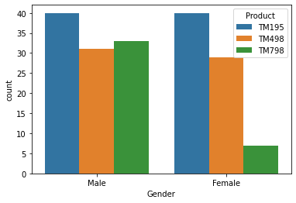
sns.countplot(x="Gender",hue='Product',data=myData)

Slide 24
pd.pivot_table(myData,'Income',index=['Product','Gender'],columns=['MaritalStatus'])
MaritalStatus |  | Partnered | Single
Product | Gender
TM195 | Female | 46153.777778 | 45742.384615
 | Male | 50028.000000 | 43265.842105
TM498 | Female | 49724.800000 | 48920.357143
 | Male | 49378.285714 | 47071.800000
TM798 | Female | 84972.250000 | 58516.000000
 | Male | 81431.368421 | 68216.428571

Slide 25
pd.pivot_table(myData,'Miles',index=['Product','Gender'],columns=['MaritalStatus'])
MaritalStatus | Partnered | Single
Product | Gender
TM195 | Female | 74.925926 | 78.846154
 | Male | 80.190476 | 99.526316
TM498 | Female | 94.000000 | 80.214286
 | Male | 87.238095 | 91.100000
TM798 | Female | 215.000000 | 133.333333
 | Male | 176.315789 | 147.571429

Slide 26
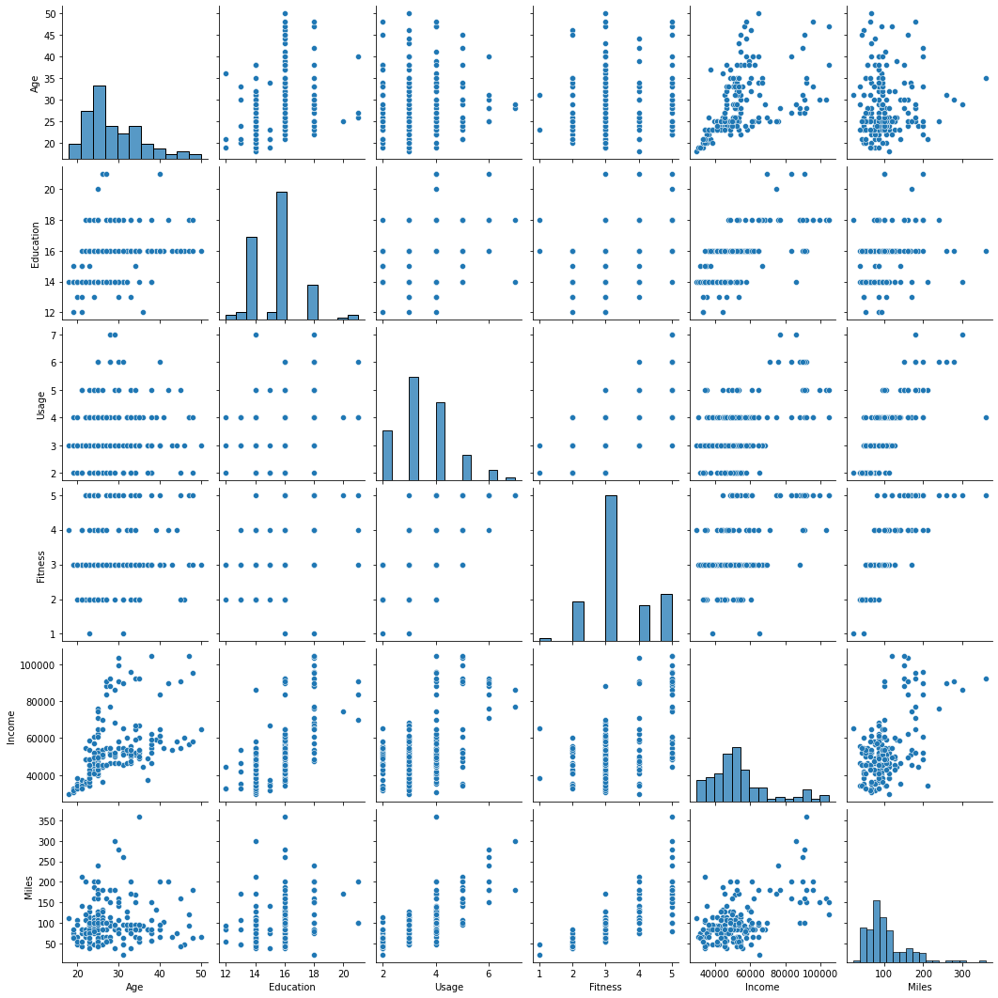
sns.pairplot(myData)

Slide 27
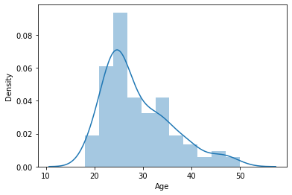
myData['Age'].std()
output
6.943498135399795
myData['Age'].mean()
output
28.788888888888888
sns.distplot(myData['Age'])

Slide 28
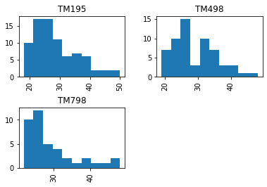
myData.hist(by='Product',column='Age')

Slide 29
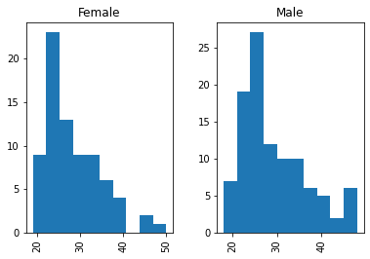
myData.hist(by='Gender',column='Age')

Slide 30
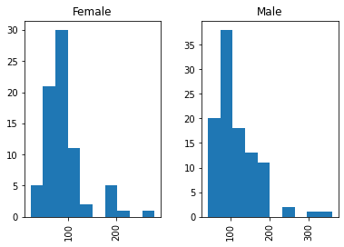
myData.hist(by='Gender',column='Miles')

Slide 31
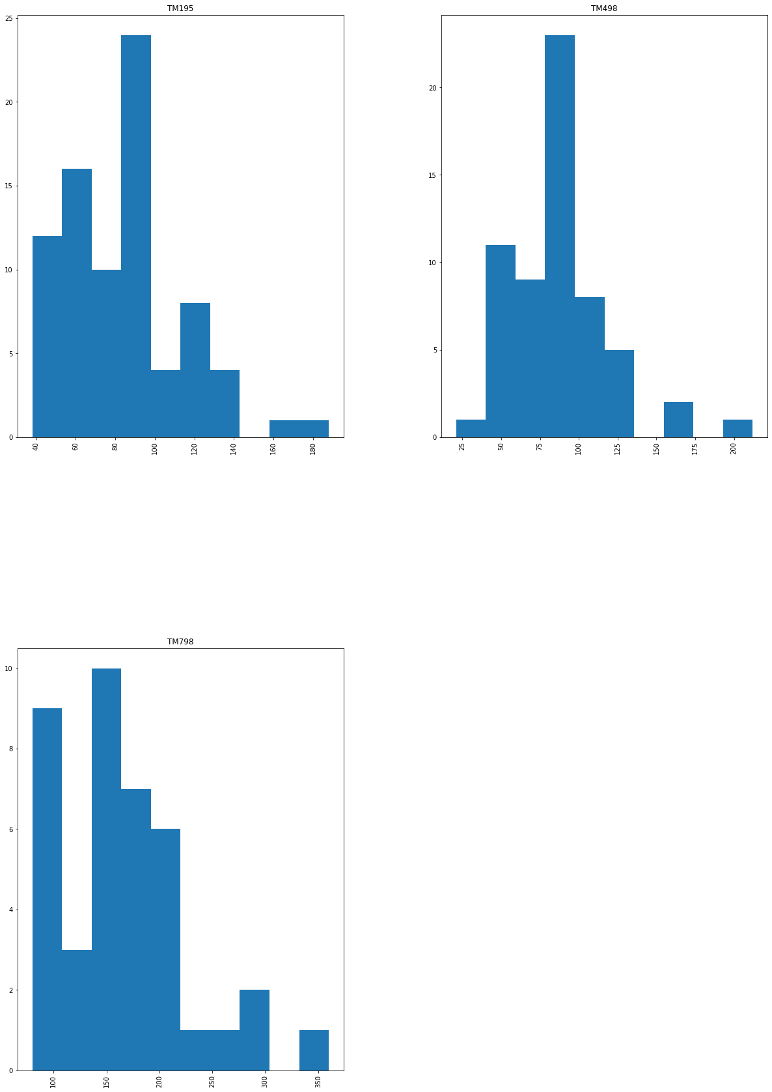
myData.hist(by='Product',column='Miles',figsize=(20,30))

Slide 32
corr=myData.corr()
corr
Age | Education | Usage | Fitness | Income | Miles
Age | 1.000000 | 0.280496 | 0.015064 | 0.061105 | 0.513414 | 0.036618
Education | 0.280496 | 1.000000 | 0.395155 | 0.410581 | 0.625827 | 0.307284
Usage | 0.015064 | 0.395155 | 1.000000 | 0.668606 | 0.519537 | 0.759130
Fitness | 0.061105 | 0.410581 | 0.668606 | 1.000000 | 0.535005 | 0.785702
Income | 0.513414 | 0.625827 | 0.519537 | 0.535005 | 1.000000 | 0.543473
Miles | 0.036618 | 0.307284 | 0.759130 | 0.785702 | 0.543473 | 1.000000

Slide 33
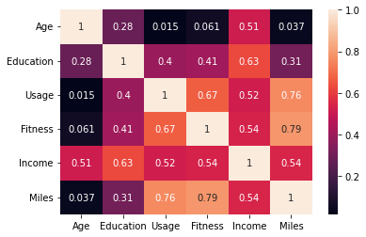
sns.heatmap(corr,annot=True)

Slide 34
#simple linear regression
#load function from sklear
from sklearn import linear_model
#create linear regression object
regr=linear_model.LinearRegression()
y=myData['Miles']
x=myData[['Usage','Fitness']]
regr.fit(x,y)
output
LinearRegression()
--------------------
regr.coef_
Output
array([20.21486334, 27.20649954])
-------------------------------------
regr.intercept_
output
-56.74288178464856

Slide 35
#miles predicted=
-56.74288178464856+20.21486334*Usage+#miles predicted=-56.74288178464856+20.21486334*Usage+ 27.20649954*fitness

